Slide 2
Minor Project – I Project Title: Ping pong
Member’s Name | Roll no. | SAP Id | Branch
Udit Kumar | R134219125 | 500077853 | CSE-CSF
S Sumeet | R134219120 | 500077762 | CSE-CSF
Shivani Saran | R134219018 | 500075219 | CSE-BAO
Utkarsh Sharma | R134219028 | 500077646 | CSE-BAO
Under the guidance of
Mr. Bikram Pratim Bhuyan

Slide 3
CONTENTS
1. Introduction
2. Motivation
3. Literature Review
4. Problem Statement
5. Objective
6. Flow Chart
7. Methodology
8. Status of the project
8.1 ball
8.2 paddle
9. Pseudo Code
10. Experimentation
11. Result and Discussion
12. Conclusion and future scope
13. limitations
14. References

Slide 4
Introduction
Ping pong is one of the oldest video game.
It was created by Nolan Bushnell and Ted Dabney
Nolan Bushnell took inspiration for pong from a table tennis game.
A pong game consists of two paddles and a ball.
The player has to make sure that he hits the ball with the paddle without missing it to score points.

Slide 5
Motivation
This project has three primary motivations:
To come up with a realistic Ping Pong game experience.
To enhance our coding skills.
To develop our communication skills and group working skills.

Slide 6
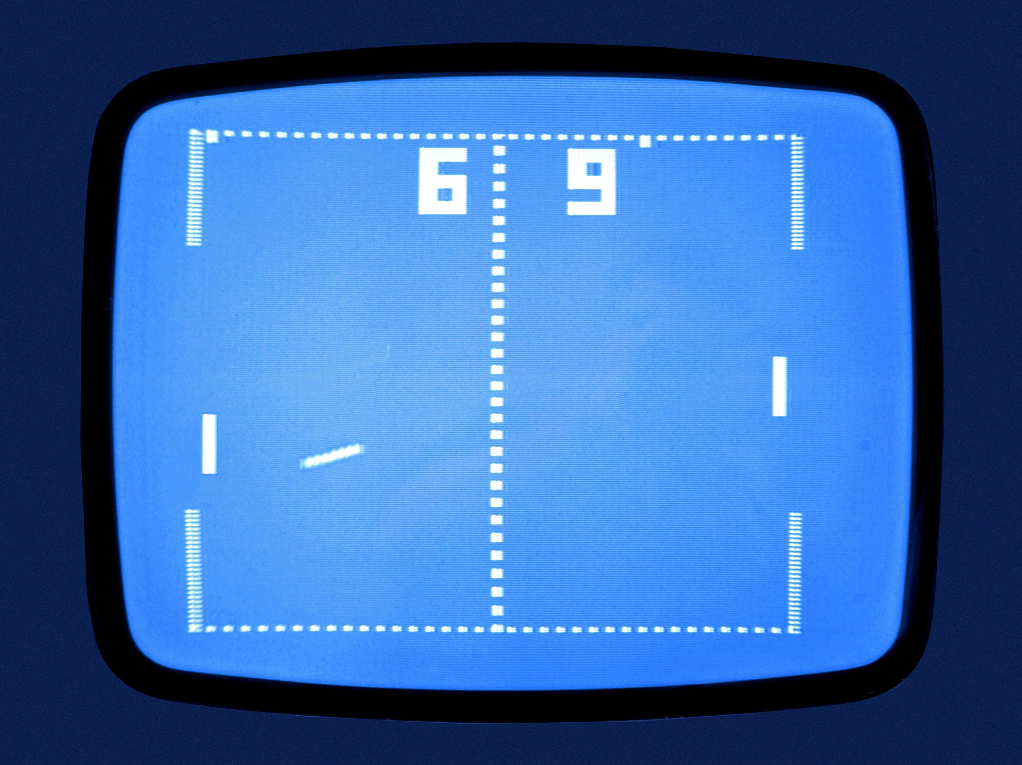
Literature Review
Ping pong was first developed by Atari company
It became a pioneer in arcade games.
Pong was a sensation for players because it successfully combined digital electronics with a TV display to create a new medium for gameplay.
Pong set off a game revolution, overnight hit (sold 100,000 units) .

Slide 7
PROBLEM STATEMENT
People who are interested in gaming will be included in the target audience.
By the end of this project, we will create a simple functioning pong game using java.
In this project we’ll use [processing 4] which is an open source IDE and it’s very simple to write our code in , which will help us implement all the needed functions and classes that are necessary to build our game.

Slide 8

Objective
The objective is to hit the ball with paddle so that it goes to the opposite side and vise-versa . And if the opponent unable to return the ball back in this way we can score points

Slide 9
Flow chart
Start
Initialise
score
with 0
Check if the ball touches the paddle or cross the window
Ball bounce by 90 degree
Kick of the game from center of the window
touches
Game continue
Cross the border
Whichever paddle misses the ball, its opponent score will be increased by 1
Game ends when the game window is shut down
END

Slide 10
Methodology
draw a window and its edges in x,y coordinate system
Make a ball and move it in x and y direction.
Stop passing the ball from bottom and top of the window.
Make two paddles and move them through the keyboard input in y direction.
Ball bounce when it collide with any of the paddle.
Ball start moving again from center when it passes out of the window from left and right side and increase the score.

Slide 11
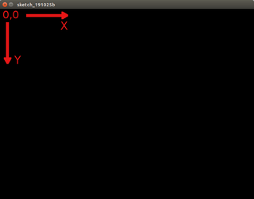
Project status
Computer graphics window
Size of the window.
Background color of the window.
Prevent the ball from going up and down side of the window.
Show score on the window.
To increase the score when the ball is passed from the right and left side of the window.

Slide 12
Ball
Class: Ball
Display a ball .
Move the ball in x,y direction in the window.
Collision detection between the paddle and ball.
Ball bounce by 90 degree.
Whenever ball passes from right side or left side of the window
Increase the score and placed the ball again at the center.
(x,y)
r

Slide 13
paddle
w
Class : Paddle
Make two paddles. One at right side of the window and another at left side.
Move the paddle from the keyboard input.
Stop the paddle from going out of the window.
Collision detection between paddle and the ball.
(x, y)

Slide 14
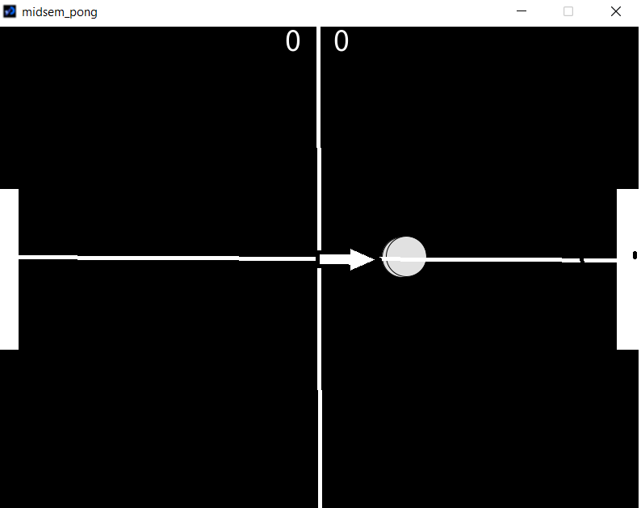
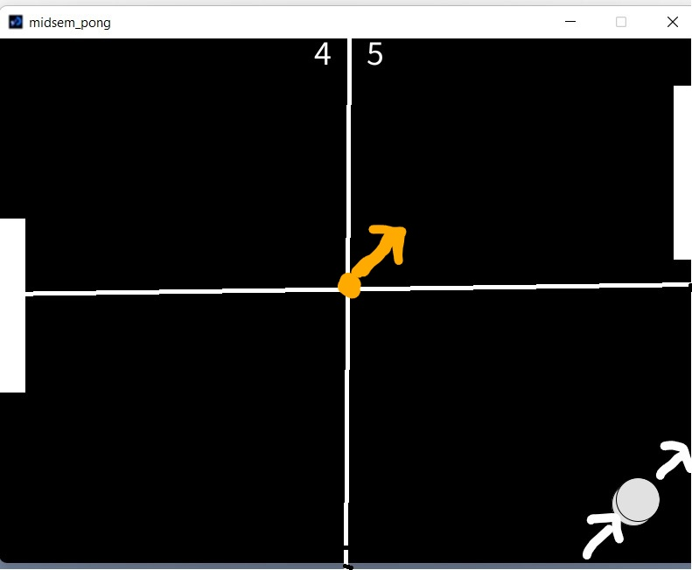
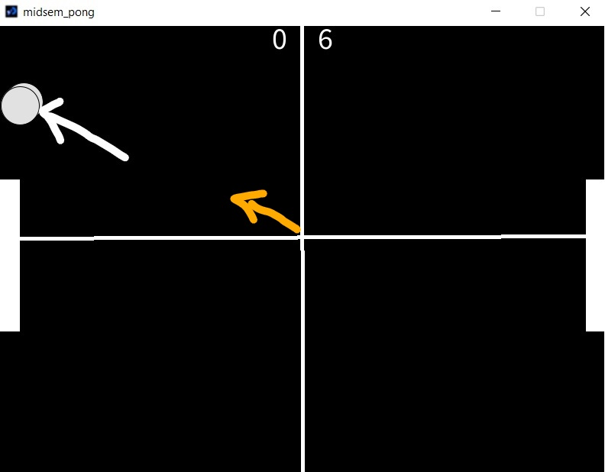
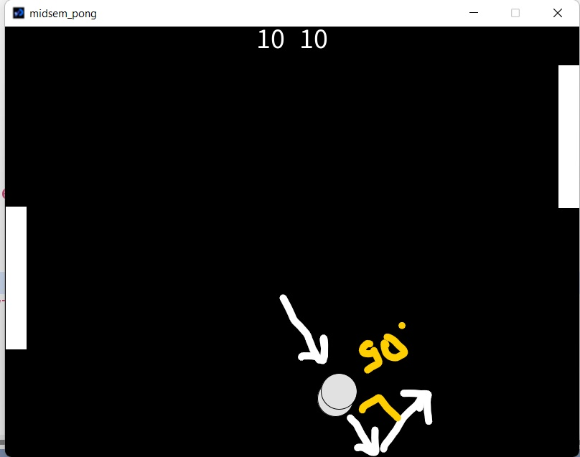
Experimentation

Slide 15
Result And Discussion
Earlier glitches in the game.
With angle
Display of the score
With paddle.

Slide 16
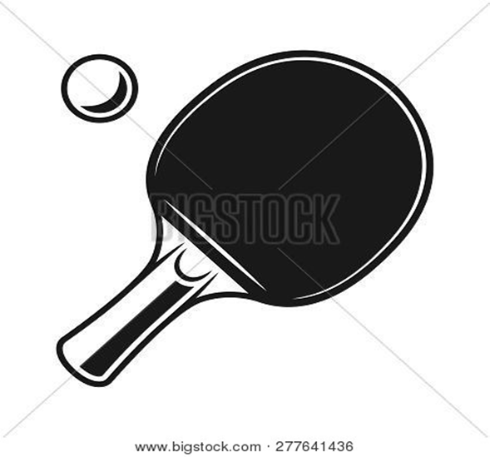
Future Scope and Application
can be used as an AI for single player game.
Multiplayer (online platform).
We also wanted a way to record wins
and losses over time.

Slide 17
Limitations
Capable of playing ping-pong against human opponent using a AI.
After missing ball,it starts from that point from where the last time ball was missed.

Slide 18
References
Kathy Sierra, Bert Bates . (2003) . Head first java . O'Reilly Media
SOMASHEKARA , M. T., GURU, D. S., MANJUNATHA . (2017) . Object Oriented Programming with Java . Somashekara media
Bellis M., Atari: History of the entertaining Atari video system andgame computer, April (2017)
https://en.wikipedia.org/wiki/Pong
https://www.tutorialspoint.com/java/index.htm

Slide 19
